Slide 1

SMART INDIA HACKATHON 2026
TITLE PAGE
Problem Statement ID – SIH26184
Problem Statement Title – Development of a Predictive Analytics Framework for Cybercrime Complaints to Forecast Likely Cash Withdrawal Locations in Advance, Enabling Generation of Actionable Intelligence for Timely and Proactive Cybercrime Intervention.
Theme – Blockchain & Cybersecurity
PS Category – Software
Team ID – UNFAZED
Team Name – UNFAZED

Slide 2
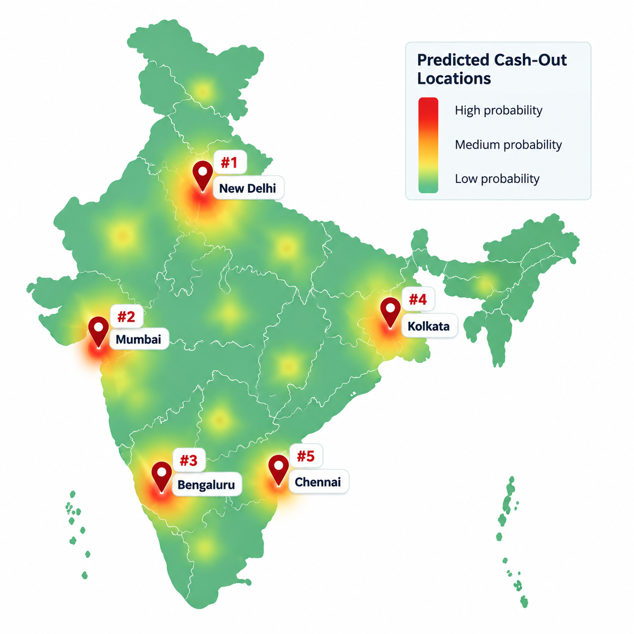
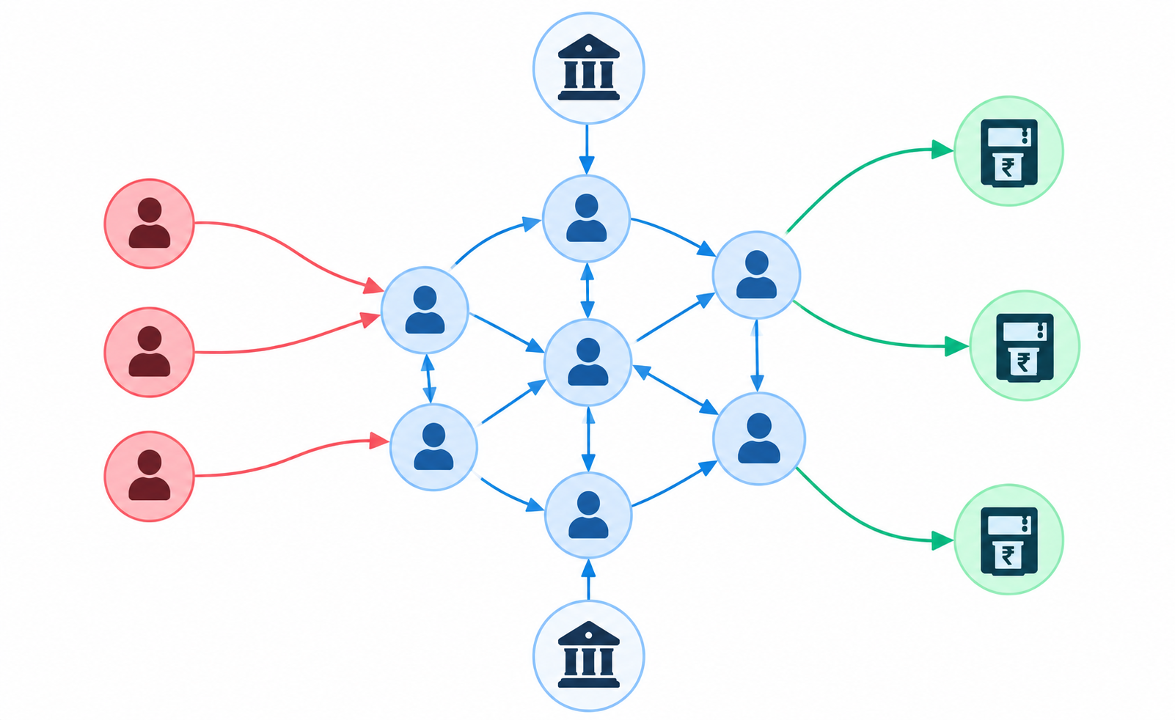
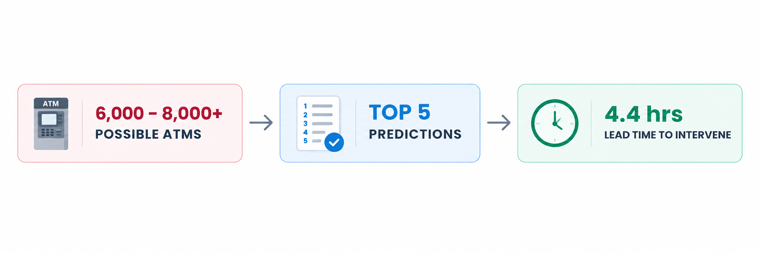
IDEA TITLE - Predictive Fund-Flow Analysis for Cybercrime Investigations
UNFAZED
Proposed Solution:
OUR SOLUTION
NOVELTIES
THE PROBLEM
Point-in-Time Graph Intelligence
  Rebuilds the entire graph when complaint is filed, preventing data-leakage flaw that inflates accuracy.
Cross-Complaint Network Discovery
  Identifies fraud networks, related accounts and other victims cases.
Closed Feedback Loop
  Auto-Retrains based on investigator’s feedbacks.
Explainable & Calibrated Predictions
  Confidence scores are backed by the factors that influenced each prediction.
Fraud Network Velocity Alerts
  Ranked by how fast they’re adding new complaints, giving priority to fast-growing networks.
Investigations start too late.
Fund moves across fraud networks & multiple accounts.
Large cash-out locations causes slow investigation.
Lack of explainable predictions makes it hard to decide location.
Predicts cash-out with 4.4 hours lead time (vs baseline model)
Identifies Fraud Networks by linking complaints & transactions.
Shortlists the Top 5 locations from all possible withdrawal points.
Shows the explainable reasons, along with its confidence score.
FRAUD
NETWORK
VICTIMS
CASHOUT
ATMS

Slide 3
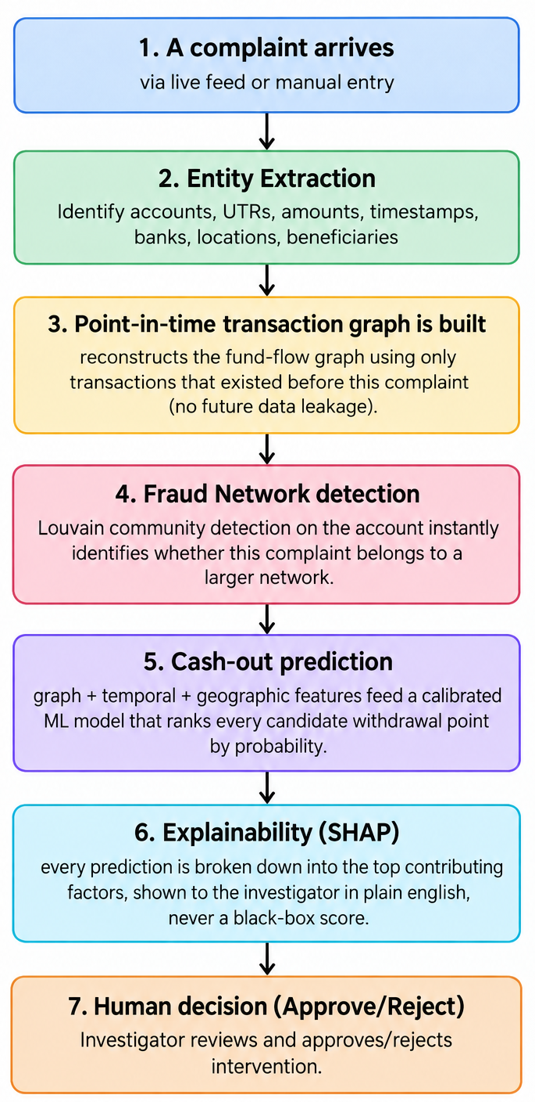
TECHNICAL APPROACH
UNFAZED
WORKFLOW
TECHNOLOGIES USED
BACKEND:
  Python - Language for the API, ML pipeline, and graph engine
  FastAPI - REST API framework
  Uvicorn - Server
  SQLite (demo) - Database, designed to be Postgres for production
  Pydantic - Request/response validation
MACHINE LEARNING:
  XGBoost - Gradient-boosted ranking model
  scikit-learn - Calibration, baseline model, evaluation metrics
  SHAP - Model explainability
  pandas / NumPy - Data processing and feature engineering
  NetworkX - Transaction graph, Louvain community detection (fraud ring discovery)
FRONTEND:
  React 18 · Vite · Recharts · Leaflet (Maps)· react-force-graph-2d (Network Vizualization)

Slide 4
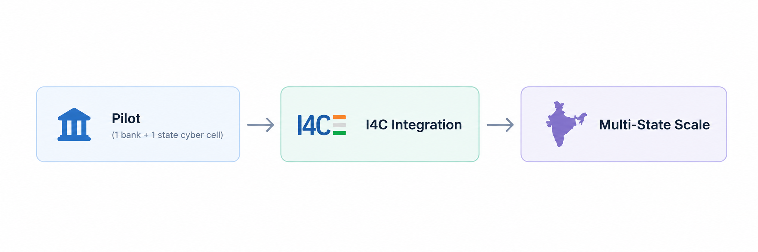
FEASIBILITY AND VIABILITY
UNFAZED
FEASIBILITY
CHALLENGES
Working end-to-end pipeline: Complaint → Graph → Prediction & Explanation → Fraud Networks & Heatmaps → Alerts to Banks & Police Stations.
Zero licensing cost: 100% open source stack.
Lightweight compute requirements: Runs on normal infrastructure. No GPU clusters required.
Self-sustaining data flywheel : Investigator decisions retrains model. Continuous improvement without manual labelling.
Validated at real scale: 700+ complaints, 1,600+ accounts, 2,400+ transfers, 200 ATMs, 5 cities.
Fits existing investigator workflow: Investigators keep the exact decision authority they already have, the system leads the investigation.
Data Silos: Live data from different banks & states requires MoUs & API integration.
Scaling Issues with Graph: Full graph rebuild is not optimal at national scale
Evolving Patterns: Fraud networks change patterns & behaviours overtime.
Privacy: Victim’s sensitive data requires DPDP Act-grade data protection.
STRATEGIES FOR OVERCOMING CHALLENGES
Phase Launch: One bank + state cyber cell → Scale to multiple.
Incremental Graph Updates: Update only new affected parts of graph.
Continuous retraining: Retraining using newly closed cases to adapt to evolving behaviour. Decisions are labelled for retraining.
Privacy: Display obfuscated codes instead of raw sensitive data.
DEPLOYMENT ROADMAP

Slide 5
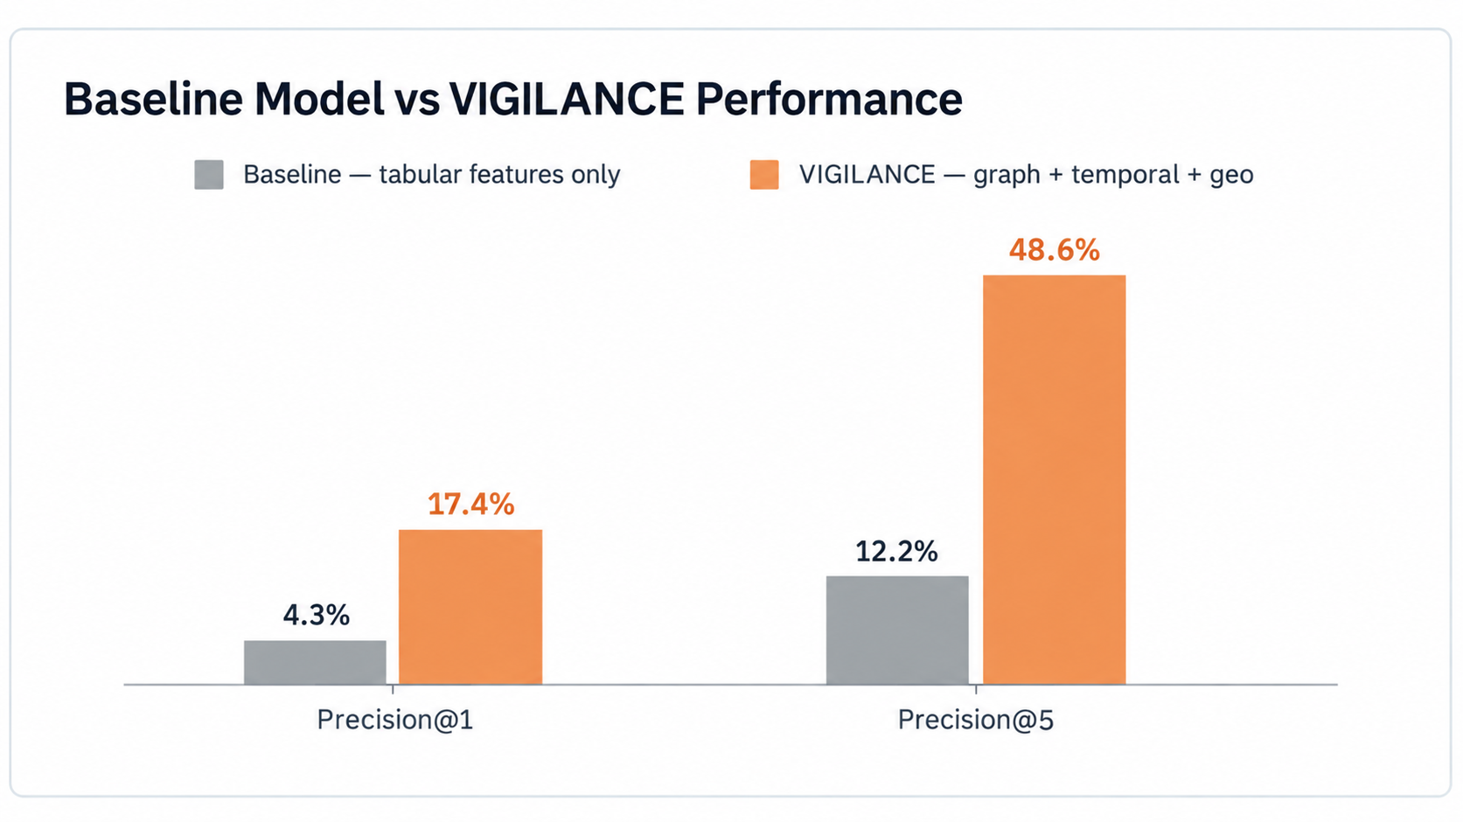
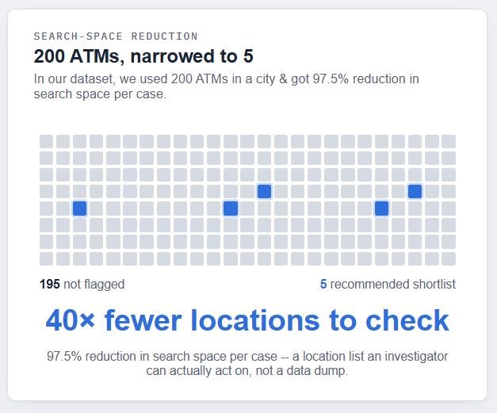
IMPACT AND BENEFITS
UNFAZED
IMPACTS ON CYBERCELLS
SOCIAL & ECONOMICAL BENEFITS
Faster investigations: Reduces hundreds of possible withdrawal endpoints to a ranked Top-5 shortlist
Earlier intervention: In our modeled dataset, 121 of 138 test cases had a real filing-to-cash-out window, averaging 4.4 hours.
Fraud Network visibility: One complaint can uncover 30-40+ linked mule accounts and other victim cases, expanding investigative reach.
Measurable Performance: Prototype shows 48.6% Precision@5 vs 12.3% Baseline, with an average 4.4-hour lead time.
Unclear cases to Clear Priorities: Automatically shows HIGH-urgency cases, helping focus on the important cases first.
Higher recovery potential: Earlier intervention can improve chances of actual victim recovery.
Public trust: Strengthens confidence in India's growing digital-payment ecosystem.
Lower investigation cost: Reduces manual tracing effort and helps cyber cells handle more cases.
National-scale impact: India loses thousands of crores annually. Small lift in recovery is crores at national volume.

Slide 6
RESEARCH AND REFERENCES
Your Team Name
Lundberg, S.M. (2017) -"A Unified Approach to Interpreting Model Predictions." NeurIPS 2017.
Blondel, V.D., Guillaume, J.-L., Lambiotte, R., & Lefebvre, E. (2008). "Fast unfolding of communities in large networks." Journal of Statistical Mechanics: Theory and Experiment, 2008.
Digital Personal Data Protection Act, 2023 (Act No. 22 of 2023), Government of India, Ministry of Electronics & IT.
Weber, M., Domeniconi, G., Chen, J., Weidele, D.K.I., Bellei, C., Robinson, T., & Leiserson, C.E. (2019). "Anti-Money Laundering in Bitcoin: Experimenting with Graph Convolutional Networks for Financial Forensics." KDD '19 Workshop on Anomaly Detection in Finance

